Slide 1

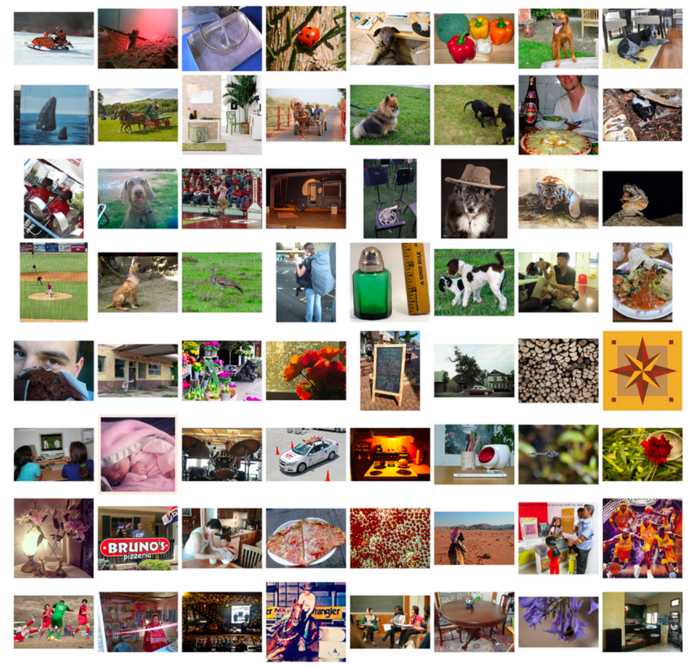
The Identification Game
Team: Bernoulli
Members: Sokratis Anagnostopoulos, Zhenxia Shen, Yang Ye, Nikolas Vornehm, Yusen Zhou
github repo: https://github.com/acse-2019/acse4-4-bernoulli
Image from: https://bit.ly/2WSu8ls

Slide 2
Contents
Methodology / Workflow
Models
Augmentations
Layer freezing
Model Stacking
Results & Conclusion

Slide 3
1. Methodology / Workflow
1. Distribute base code for loading data and training
2. Transfer learning from pretrained models
ResNet variations
(Sokratis, Shen)
GoogleNet variations
(Nikolas, Yusen)
DenseNet
(Yang, Yusen)
Vgg, HardNet
(Shen, Yang)
3. Parametric Studies
Hyperparameters
(Shen, Yang)
Augmentations
(Sokratis, Nikolas, Yusen)
Layers freezing
(Nikolas)
Resizing & Batch size
(Sokratis)
4. Model stacking / ensemble

Slide 4
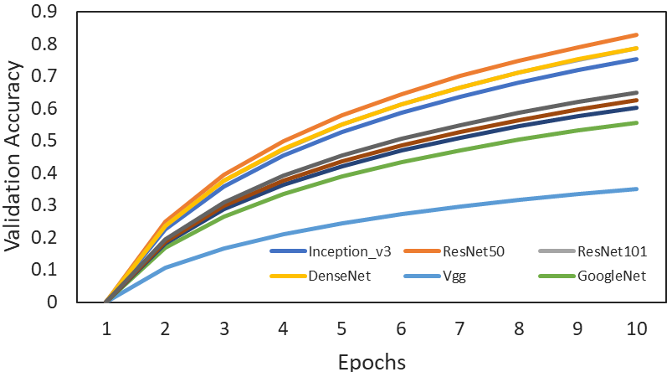
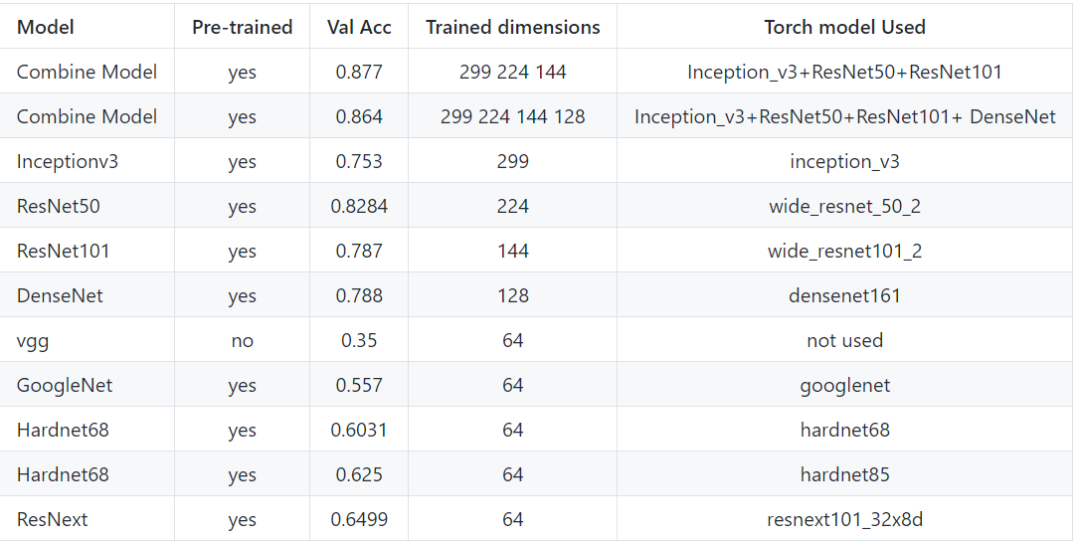
2. Models
Figure 1. Indicative graphs of model validation accuracies for an average of 10 epochs (left) and model information (right).

Slide 5
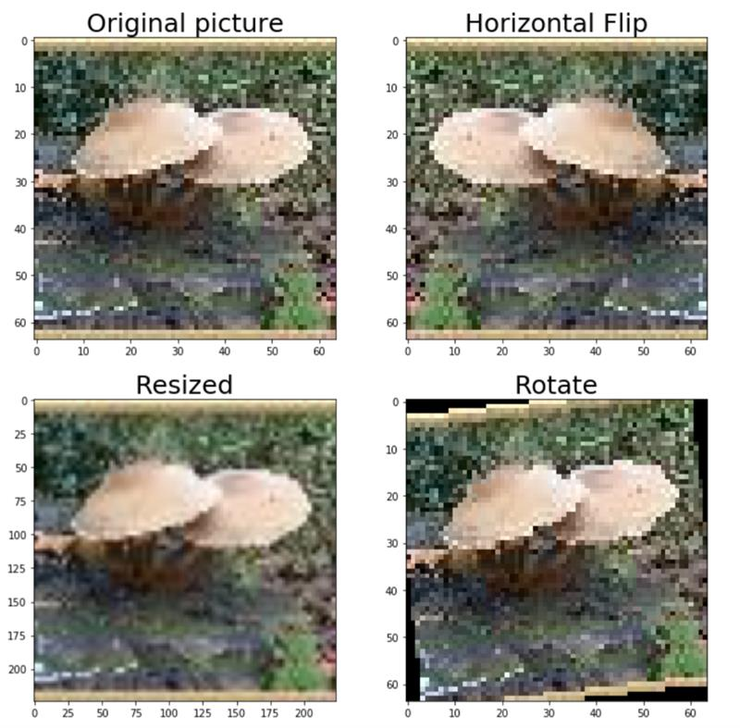
3. Augmentations
Examples:
Resizing (up-scaling) had the most significant effect in the Validation accuracy due to two main reasons:
Acts as Gaussian noise since it applies interpolation
Increases the dimension of the input, taking advantage of the large number of parameters of the pretrained models, even if the Dataset is small
Figure 2. Indicative augmentation techniques used.

Slide 6
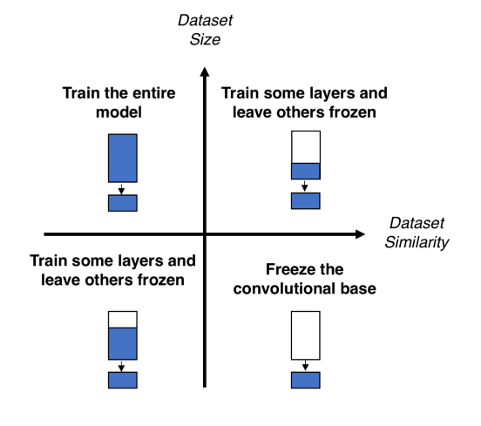
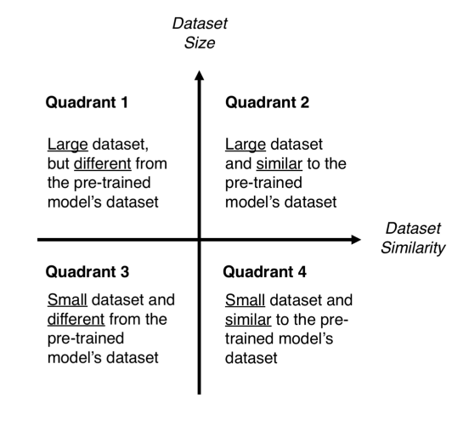
4. Layer freezing
Figure 3. Freezing layers scenarios. Image from: https://bit.ly/3gfbaNO.
Based on the above, our case lies within the 4th Quadrant, since the examined dataset could potentially represent a small subset of ImageNet.

Slide 7
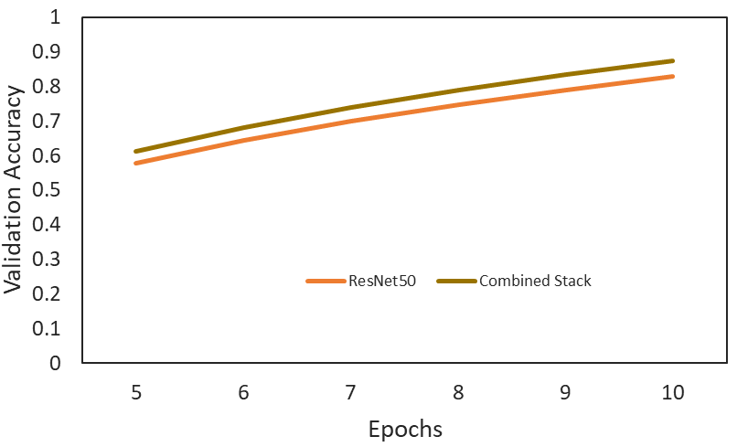
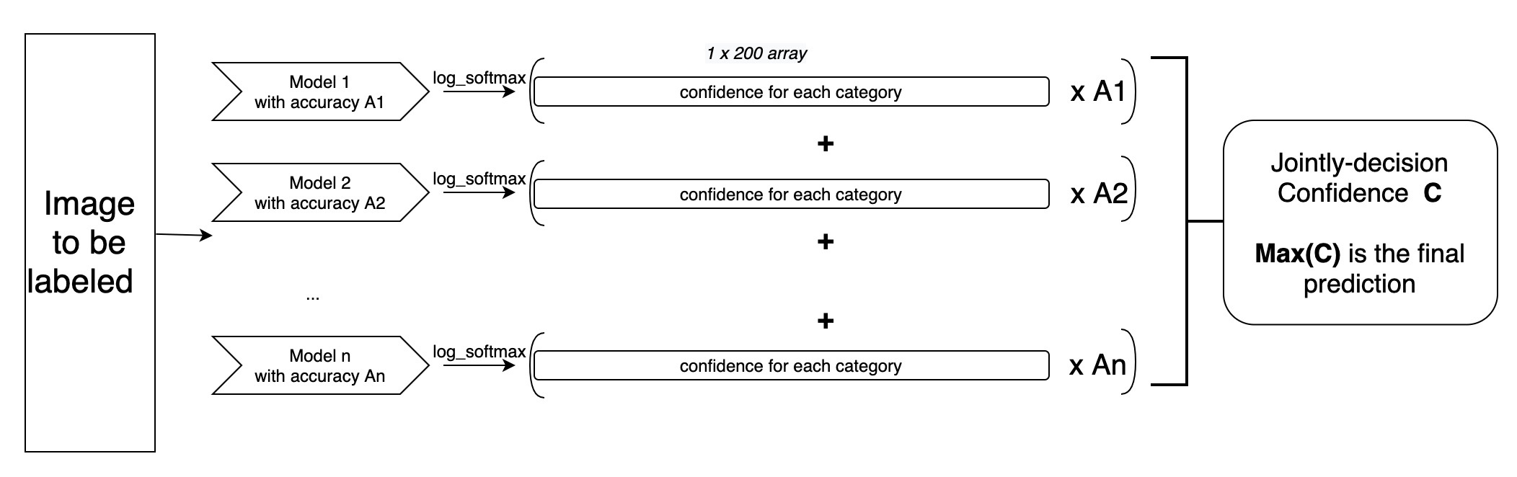
5. Model Stacking
Things we tried:
Most of the trained model combinations (allocated to different team members). Note that similar models can be used since they have probably converged to different local minima.
Each model accuracy was factored via spreading with:
Softmax / Log_softmax / Log^2_softmax / Log^3_softmax functions.
Figure 4.1 Stack improvement in Accuracy (~4.5%)
Figure 4.2 Our Model Stacking diagram.

Slide 8
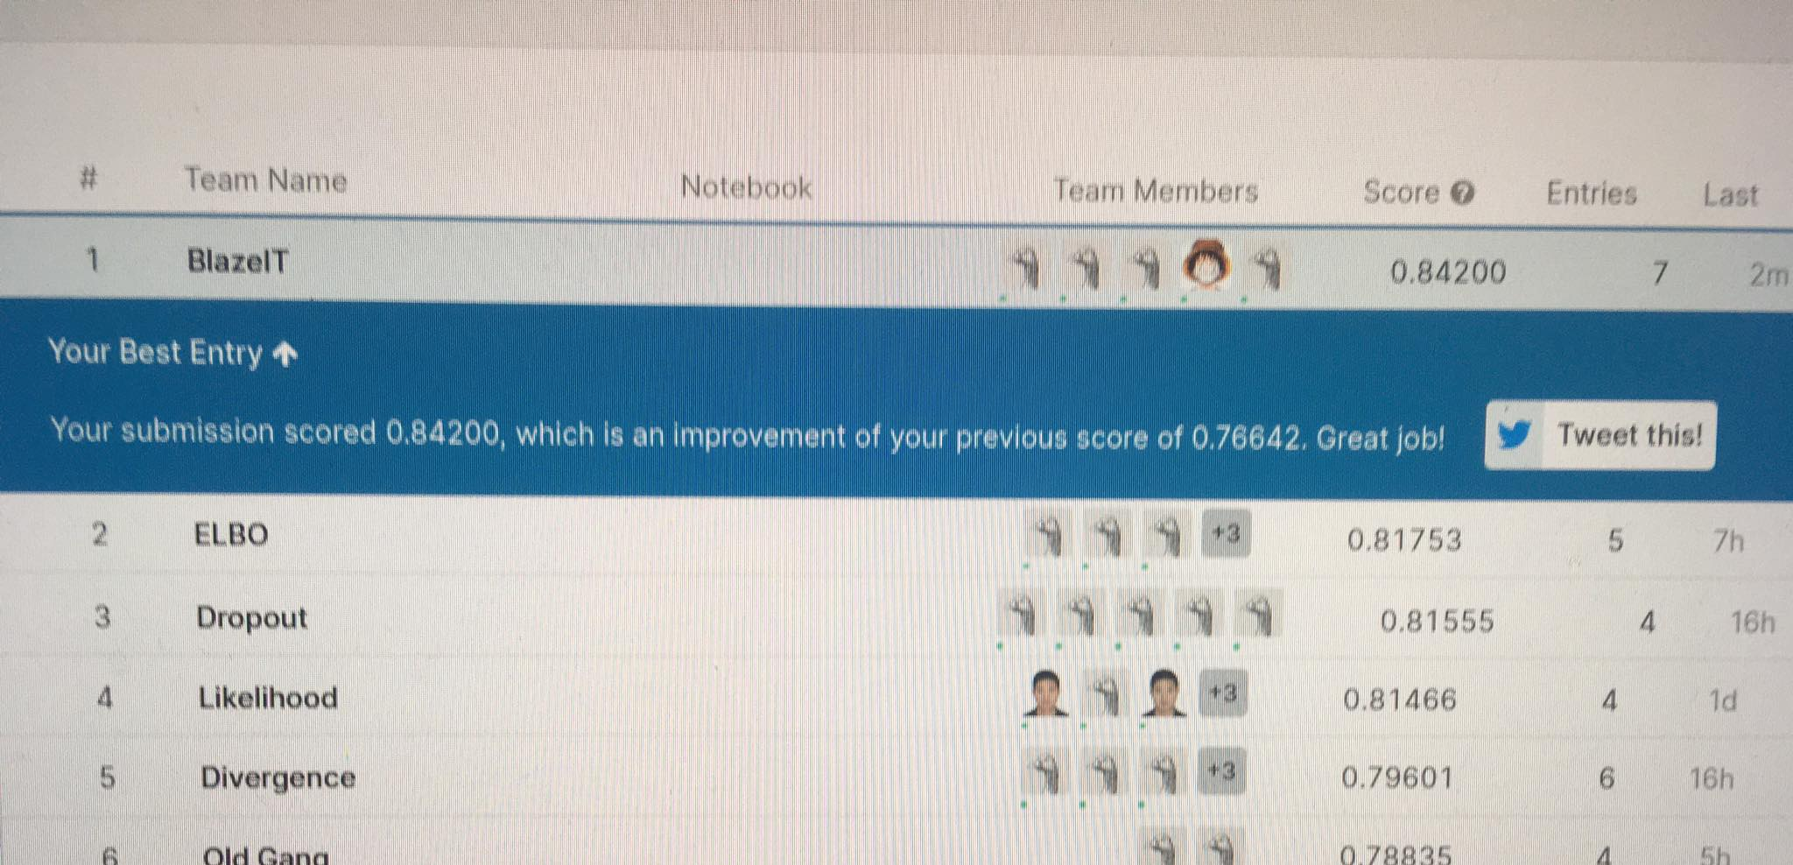
6. Results & Conclusion
A. 3rd place in the competition!
B. Local validation accuracy of 87.5%
(unfortunately we did not manage to submit this one)
C. Efficient model training and validation script
D. Generalised ensemble code for future studies
E. Integrated library for general purpose CNN studies
F. Further improvements: Retrain on the full dataset, use more stable environments for GPU training.
Figure 5. Our brightest moment

